Slide 1
OpenMash Innovation
Harnessing the Power of the Community
OpenMash Team
6/13/2013

Slide 2
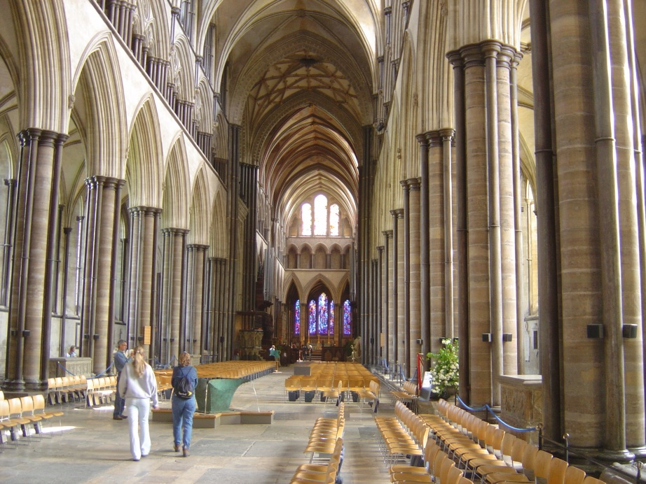
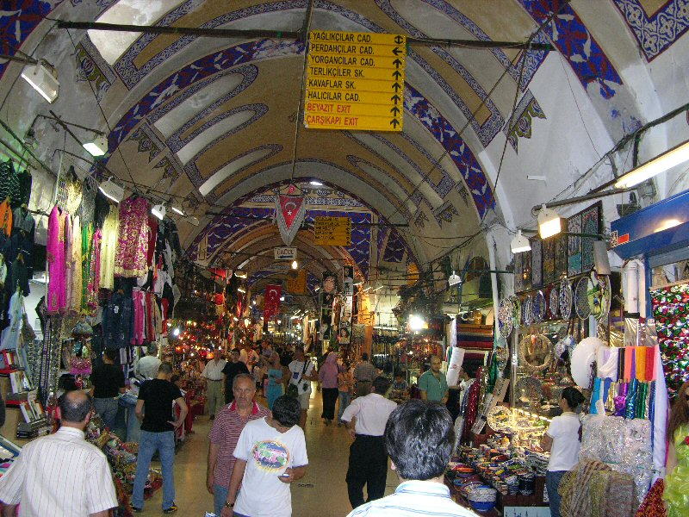


Cathedral and Bazaar
Veterans
Administration
OSS Community
Healthcare
Delivery
Software Products
& Services
Apache Software
Foundation
OSS Community
IT
Marketplace

Slide 3
Ride Sharing
Ride Sharing
Volunteer Coordination
General Purpose Volunteer Scheduling
General Purpose Resource matching

Slide 4
Solution Elements
People Power
Efficient Collaboration through Coordination
Measurement
Bottom-up Innovation Meets Top-Down Governance

